Slide 1

CENTRAL UNIVERSITY OF RAJASTHAN
AUTOMATE ATTENDANCE USING FACIAL RECOGNITION USING MACHINE LEARNING TECHNIQUES
PRESENTED BY:
Shrish Somawat
2019IMSCS030
SUPERVISOR:
Mr. Ravi Raj Chaudhary
Assistant Professor
Department of Computer Science

Slide 2
OUTLINE
AIM
INTRODUCTION
BASIC STRUCTURE
ACTIVITY DIAGRAM
SOME FUNCTIONS OF THE CODES
FINAL RESULT
CONCLUSION

Slide 3
AIM
THE AIM OF THIS PROJECT IS TO DESIGN AN AUTOMATED ATTENDANCE SYSTEM USING FACE RECOGNITION THAT WOULD BE A BETTER ALTERNATIVE TO A MANUAL PAPER-BASED ATTENDANCE RECORDING SYSTEM.

Slide 4
INTRODUCTION
FACE RECOGNITION technology is gradually evolving into a universal biometric solution since it requires virtually zero effort from the user end compared with other biometric options.

Slide 5
ATTENDANCE TECHNIQUES COMPARISIONS
TECHNIQUES | TIME SAVING | ACCURACY | SECURITY
FACE RECOGNITION |   ✓ | ✓ | ✓
CLASSICAL METHOD | ✗ | ✗ | ✗
RFID METHOD | ✗ | ✓ | ✓
FINGERPRINT READER MEHTOD | ✗ | ✓ | ✓

Slide 6

High Def Camera
BASIC STRUCTURE
STUDENTS
Board

Slide 7
ACTIVITY DIAGRAM
STORED IMAGES
IMAGE ACQUISITION
STUDENT
IMAGE PROCESSING
PREPROCESSING
FACE DETECTION
FACE RECOGNITION
MARKING ATTENDANCE IN THE DATABASE

Slide 8
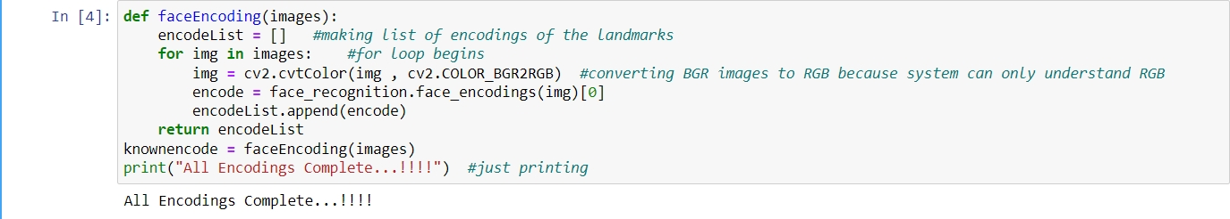
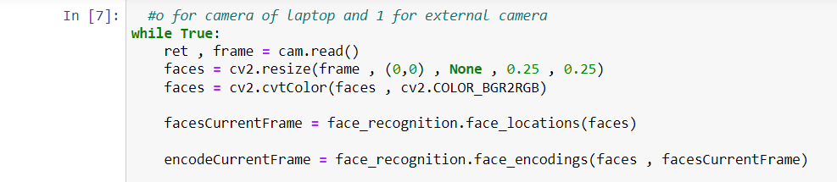
Some functions of codes
SO FAR I HAVE TAKEN OUT THESE CONCLUSIONS FROM MY PROJECT:
Applying encodings on the faces
2. Reading cameras frame and resize them into general frame.

Slide 9
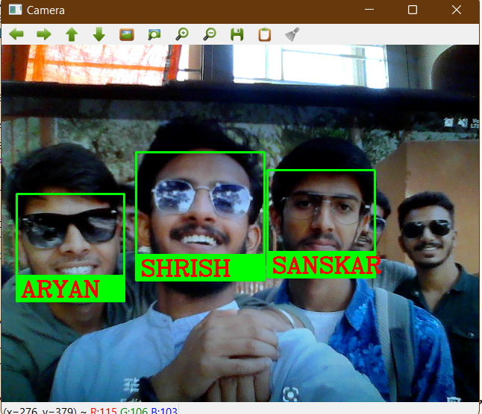
Glimpse of Result:

Slide 10
Attendance using the model
By my model now I will record the attendance which will be saved in an excel sheet that will store the time date and name of the student.

Slide 11
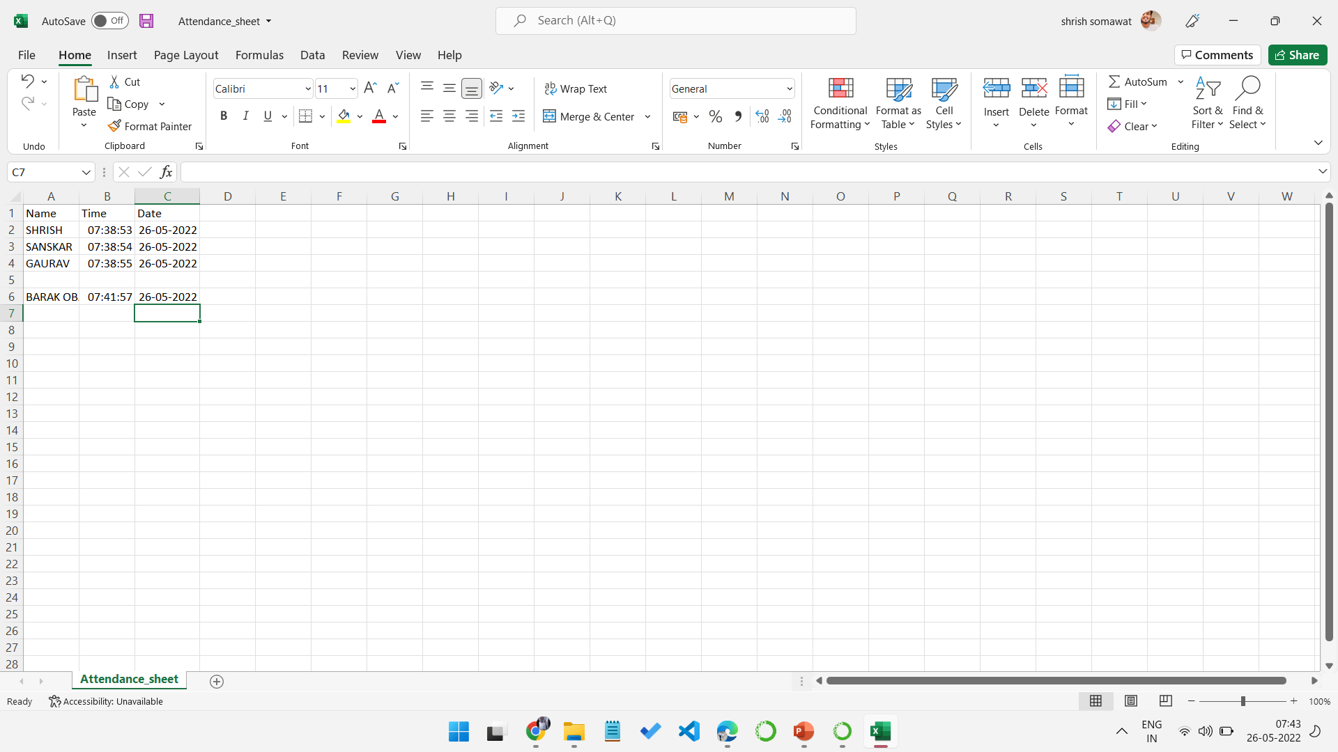
Result of the attendance stored

Slide 12
CONCLUSION:
This technique described the accurate and efficient method of automatic attendance in the classroom which could replace the traditional method.
No need for installing complex hardware for taking attendance in the classroom, all we need is a camera and laptop. We used algorithms that can detect and recognize faces in the image.

Slide 13
REFERENCES
1. RESEARCH GATE
2. https://www.analyticsvidhya.com/blog/2021/11/build-face-recognition-attendance-system-using-python/
3. book:- Facial Recognition Technology A Clear and Concise Reference

Slide 14
THANK YOU

